Slide 1

INTERNSHIP REPORT&PROJECT REVIEW-1
INTERNSHIP PERIOD : FROM 1/7/2022 to 31/8/2022
STUDENT NAME : ANURAAG RATAKONDA
ROLLNO : 20691A2805
CLASS : III CST - A
REVIEW DATE : 3/11/2022
INTERNSHIP MENTOR : mr. Prakash .n

Slide 2
ABOUT INDUSTRY/ORGANIZATION DETAILS
Industry name : SMART KNOWER
INTERNSHIP MODE : ONLINE
PAYMENT : 3500\-
Way of approach :Firstly they will create a whatsapp group for each college and the intrested students should give their details in the group then they will approach the intrested students by phone call for confirmation.
Venue : Banglore, India.

Slide 3
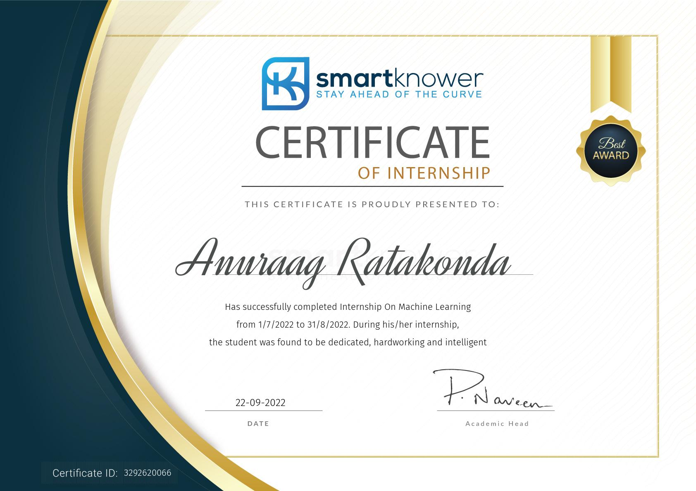
Internship Certificate

Slide 4
My Internship
Internship Description :
I have used Machine learning concept with Python language in this internship project.
I have used Google collab to run my codes for the project.
I have used 1994 Cencus bureau database by Rinny kohavi and Barry Becker dataset.
Things Learned :
I have learned how to predict the information as per the project.
I have learned how to analyse the dataset as per requirement.

Slide 5
MY PERSONAL BENEFIT
I have gained some knowledge in Machine learning.
I have learned the importance of time management.
I have learned the doing work in the given time.
I have learned how to work in a group project.
I have learned how to interact with people in a project group.

Slide 6
SPECIFIC TASKS
The title of the internship is Machine learning with python.
The project is predicting the income of a given dataset with their requirements and given techniques.
Problem statement: Create a classification model to predict whether a person makes over $50k a year.
Context: This data was extracted from the 1994 Census bureau database by Ronny Kohavi and Barry Becker (Data Mining and Visualization, Silicon Graphics).

Slide 7
SPECIFIC TASKS
The techniques I have used in my internship project:
Decision Tree
Random Forest Classifier
Logistic Regression
KNN Classifier
SVC Classifier (with linear kernel)
Confusion matrix
Classification report

Slide 8
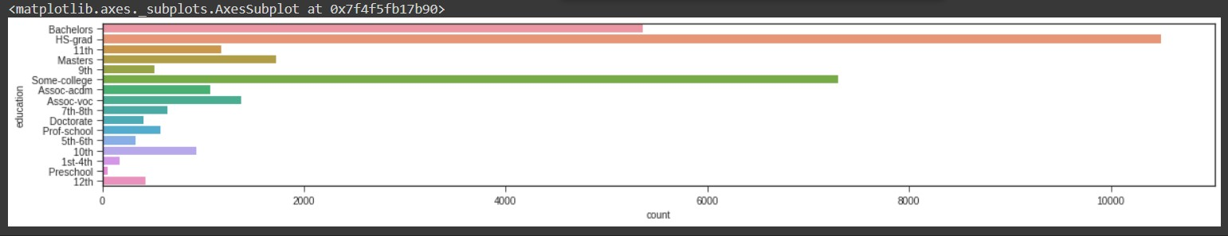
SPECIFIC TASKS
I have analysed the income in categories as per the requirement.
I have analysed the income as per their education:

Slide 9
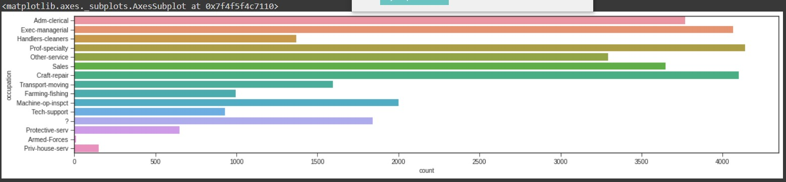
SPECIFIC TASKS
I have analysed the income as per occupation:

Slide 10
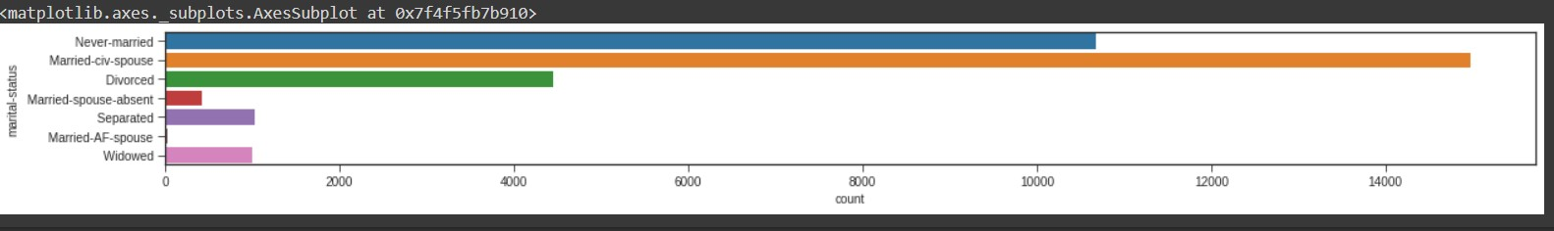
SPECIFIC TASKS
I have analysed the income as per their Marital status:

Slide 11
INTERNSHIP EXPERIENCE THE PROJECT PROPOSAL
Title of the project : Machine learning major project.
Problem statement: Create a classification model to predict whether a person makes over $50k a year.
Context: This data was extracted from the 1994 Census bureau database by Ronny Kohavi and Barry Becker (Data Mining and Visualization, Silicon Graphics).

Slide 12
INTERNSHIP EXPERIENCE THE PROJECT PROPOSAL
Objective of the project : The goal of this machine learning project is to predict whether a person makes over 50K a year or not given their demographic variation. To achieve this, several classification techniques are explored and the random forest model yields to the best prediction result.
Sources :
The dataset : Adult dataset
Link:
https://drive.google.com/file/d/11GNij0IV9hiAwW5b6xk1Oa6LF11n5QQ/view?usp=sharing

Slide 13
INTERNSHIP EXPERIENCE THE PROJECT PROPOSAL
Abstract of my project:
In this I have done a income prediction of a database according to specification.
In their previous project they have many null values, they can’t analyse the income in different categories.
In my project no null values are there and I have analysed the income in many categories.
List of categories: age, education, gender, below 50k $/year, profession.

Slide 14
FRONT END &BACK DETAILS OF THE PROJECT
I have used Machine learning techniques with python language in my project.
I have used Google collab software to run my codes for the project.
The link for code which I have worked for the project:
https://colab.research.google.com/drive/1Uwg6RiwIHOubftDqPqxHrl9xkUWGsGR?usp=sharing
The link for the dataset which I have used for the project:
https://drive.google.com/file/d/11GNij0IV9hiAwW5b6xk1Oa6LF11n5QQ/view?usp=sharing

Slide 15
CONCLUSION
THANK YOU

